Slide 1
2022 University of Utah Legal Update
November 17, 2022│ Office of General Counsel

Slide 2
2022 Legal Update Agenda
Hot Topics in Higher Education – Phyllis Vetter
University of Utah Regulations Process – Allyson Hicks
Trademarks 101 – Dennis Owens
Contracts: Key Considerations – Brian Watts
Inflation Reduction Act of 2022 – Hailey Ritchie
Legislative Update – Rebekah Bradway
Retaliation, Abusive Conduct and Whistleblower Concerns – Julie Thomas
Free Speech vs. Authority to Speak on Behalf of the Institution – Scott Smith
Q&A

Slide 3
Hot Topics in Higher Education
Phyllis Vetter

Slide 4
What Are Export Controls?
The U.S. Government actively regulates, and in some cases, restricts the export of certain information, items or technologies deemed to be critical to the interests of national security, economy and/or foreign policy.
Exporting items from the US |  | Applies to the export of items from the US by any means (shipped, hand-carried, and in the case of technical data/electronically transmitted)
Sharing controlled data and software |  | Applies to access by foreign persons wherever located, including in the U.S.
Restricted Parties |  | Transactions with restricted parties (entities and individuals) located anywhere in the world
OFAC-Sanctioned Countries |  | Transactions with governments, entities, and individuals who are resident in a sanctioned country or who are blocked entities/persons

Slide 5
Export Control Compliance is Relevant to Many Routine Activities!
Facility Clearance
International Shipping & Imports
International Travel
Student Programs
I-129 Visa Attestations
Distance Education
Technology Transfer
IT and Data Security
Controlled Biologics (Incl. Select Agents & Toxins)
Receipt of Gifts from Foreign Entities
Defense Services
Sponsored Research
Engagements & Collaboration with Foreign Entities
Procurement of items, equipment, materials, and software
Work-for-Hire/ Recharge Services

Slide 6
Foreign Influence International Collaborations are Important, Encouraged and Supported at the University of Utah
Our Mission Statement: “We generate and share new knowledge, discoveries, and innovations, and we engage local and global communities to promote education, health, and quality of life.”
Growing Research => Increased Risk: As the U’s research portfolio in critical emerging technologies increases, and as we strengthen our presence internationally, we are more likely to be the target of those who seek to leverage universities as platforms for activity that threatens US national and economic security.
Undue Foreign Influence: Influence by non-US persons or entities, including foreign governments, that seek to compromise U.S. national security and economic security or which results in loss, including by theft, of US intellectual property and academic and/or commercialization opportunities.

Slide 7
Foreign influence controls must be well-targeted, strategic, and intended to minimize risk while supporting the U’s academic and research work.
Help is available:
Office of Foreign Influence (training, analysis, restricted party screening)
Office of Sponsored Projects (grant applications, agency communication)
Conflict of Interest Office (Business Relationship Reporting disclosure)
Office of General Counsel (review of contracts with foreign partners)
University IT/Information Security Office (data breach, phishing emails)

Slide 8
The way to avoid undue foreign influence is Disclosure! Disclosure! Disclosure!
Where is Disclosure Required?
University Business Relationship Reporting (BRR) – disclosure of foreign relationships are included in the University’s BRR system, which must be updated at least annually and within 30 days of discovering or acquiring a new foreign or financial relationship related to professional responsibilities.
Federal agencies, including NIH, NSF, & DOD, are requiring greater disclosure of foreign relationships in grant applications.
The US Senate, with bi-partisan support, is proposing similar disclosure requirements across all federal granting agencies.
The Biden Administration’s efforts to protect US government supported R&D includes implementation of National Security Presidential Memorandum (NSPM)-33. This on-going effort, undertaken with bipartisan support, is expected to result in standardized policies and practices for disclosing information to assess conflicts of interest and conflicts of commitment among researchers and research organizations applying for Federal R&D awards.
What must be Disclosed?
Foreign compensation, resources and support, regardless of monetary value, that relate to any research endeavor, including a title, research grant, cooperative agreement, contract, award, access to a laboratory, materials, travel compensation and work incentives.
What are Potential Consequences of a Failure to Disclose?
Federal debarment, fines and penalties, missed commercialization opportunities, and long-term reputational damage to you and to the institution.

Slide 9
Key Take-Aways
Export controls apply to the transfer of items, materials, equipment, biologics, software, information, and services to foreign nationals
Export control regulations apply to many university areas including research, purchasing, shipping, advancement, travel, and collaboration
The university has a comprehensive export compliance program to help you identify and manage potential export control concerns
All university personnel should remain aware of research security concerns, such as undue foreign influence
You can decrease the risk of being a victim of undue foreign influence with complete and accurate disclosure on grant applications and your annual Business Reporting Relationship disclosure.

Slide 10
Questions?
Export Control:
Julie McAdams- Associate General Counsel- julie.mcadams@legal.utah.edu
Todd Nilsen- Associate Director, Industry Contracts, Export Control Officer- todd.nilsen@osp.utah.edu
Research Security & Foreign Influence:
Trent Foxley- Director, Office of Foreign Influence- trent.foxley@hsc.utah.edu
Julie McAdams- Associate General Counsel- julie.mcadams@legal.utah.edu

Slide 11
Telecommuting
https://workreimagined.utah.edu/
Must go through approval process
Resources - Forms – requests and agreement
No international telecommuting

Slide 12
Race-Conscious Admissions
Strict Scrutiny
Current Law:
Universities may consider race in a limited manner as part of a holistic review, provided that certain criteria are proven
Institution must prove that consideration of race is necessary to achieve a diverse student body
Institution must demonstrate that it has attempted race-neutral alternatives to achieve diversity, but those efforts have failed
Before taking race into consideration, a university must complete a comprehensive study that addresses elements outlined by courts

Slide 13
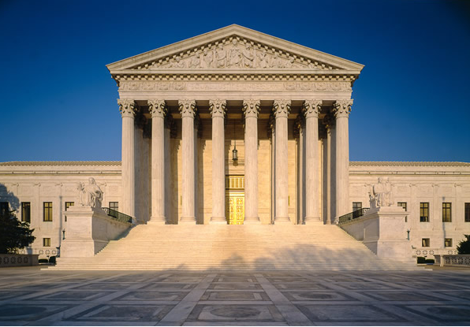
Harvard and UNC Cases
In October 2022, the U.S. Supreme Court heard oral arguments in cases challenging these universities’ admissions practices
Based on questioning in those arguments, many legal scholars believe the Supreme Court will place increased restrictions on consideration of race in admissions or will rule that universities may not consider in race in admissions at all
Stay tuned: the Supreme Court will issue its decision by the end of June 2023
REMEMBER: before implementing a scholarship or program that includes race as a consideration for participation or award, please consult with the OGC

Slide 14
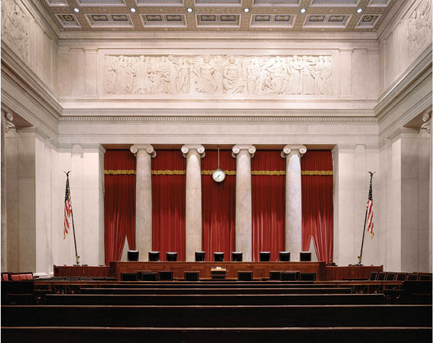
Pregnancy Termination
In June, the U.S. Supreme Court overturned Roe v. Wade, “triggering” a Utah law passed in 2020 (SB 174), which bans all pregnancy terminations except under certain circumstances
PPAU then sued and obtained a preliminary injunction, enjoining enforcement of SB 174 until the constitutionality of the law is settled
In general, under current state law, a pregnancy termination is permitted only if:
The fetus is 0-17 weeks old; or
The fetus is 18 weeks old or more, and:
The termination is necessary to avert the death of, or serious injury to, the woman;
There is a fetal anomaly; or
The pregnancy is the result of rape or incest
Information and resources for health care providers and patients available at medicine.utah.edu/obgyn/ascent/resources

Slide 15
University Regulations
Allyson Hicks
Notes:
-Good morning and thank you for being here and to OGC for giving me a couple of minutes to talk about University Regulations. I’m Allyson Hicks, director University Regulations and along with Trina Rich, who is the Director Academic Affairs Policy Administration in the Office for Faculty and Allyson Mower who is the Academic Senate Policy Liaison, we are the University Policy Team
-We are available to help with all things University Policies, including managing the regulations library, assisting with researching and drafting regulations, and advising on the review and approval process.
-University regulations apply to the whole university, and cover everything from HR, to student policies, to research policies. They do not include policies that apply only to a specific academic unit, such as college policies, or policies for the student life center.

Slide 16
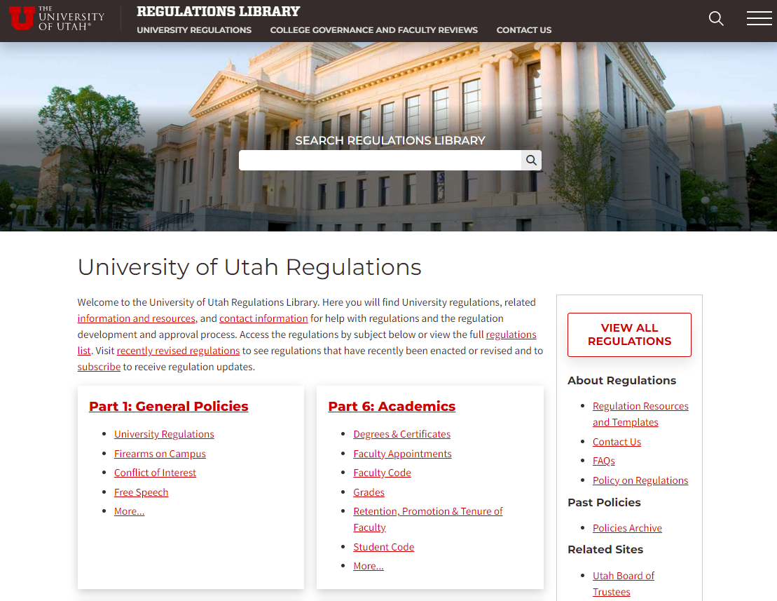
University Regulations Library
Notes:
-If you want to see if the University has a policy on something, or to review university regulations, please visit regulations.Utah.edu
-I find the best way to find a regulation is to do a keyword search in the search bar. Another option is to click “view all regulations” to browse a list of all regulations
-If you’re working on something in your own unit and want to reference a university regulation, I strongly recommend including a link to the regulation’s main page rather than quoting or paraphrasing the regulation or linking to a pdf. This way, anytime someone clicks the link they’ll get the most up to date version of the regulation.
-There are many different regulation resources on the website you can browse, but I wanted to tell you about one particular tool that is new in the last year, which is the option to subscribe to recently revised regulations

Slide 17
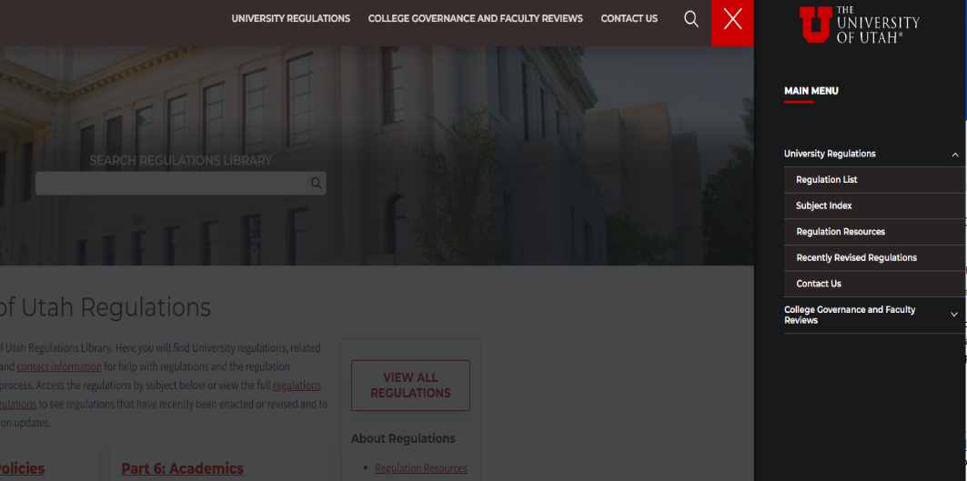
Recently Revised Regulations
Link to Subscribe: https://regulations.utah.edu/forms/subscribe.php
Notes:
-By clicking on “recently revised regulations” you can see a list of all regulations that have been updated. This list goes back to the beginning of 2021.
-If you click on subscribe and enter your name and email address, you’ll get an email from regulations.Utah.edu when regulations are changed. You can unsubscribe from the list at any time
-I’ve also included a direct link you can use if you get the slides after this presentation.
-You’ll get approximately 1 email per month with the recently revised regulations and links to the changes. This is a good way of keeping up to date on any policy changes you need to know about.

Slide 18
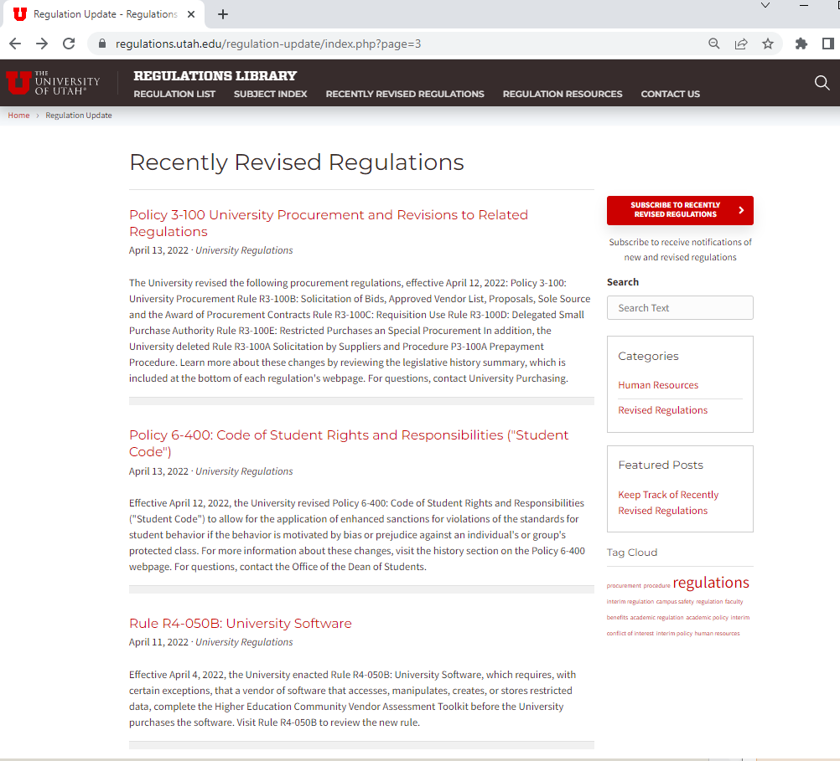
Recently Revised Regulations
Link to Subscribe: https://regulations.utah.edu/forms/subscribe.php
Notes:
-By clicking on “recently revised regulations” you can see a list of all regulations that have been updated. This list goes back to the beginning of 2021.
-If you click on subscribe and enter your name and email address, you’ll get an email from regulations.Utah.edu when regulations are changed. You can unsubscribe from the list at any time
-I’ve also included a direct link you can use if you get the slides after this presentation.
-You’ll get approximately 1 email per month with the recently revised regulations and links to the changes. This is a good way of keeping up to date on any policy changes you need to know about.

Slide 19
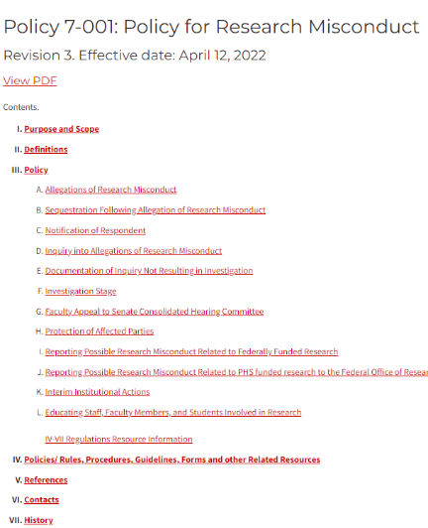
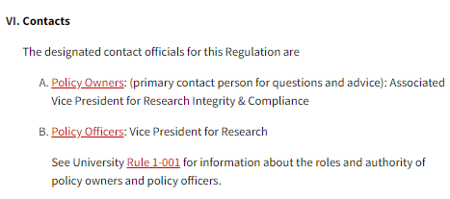
Regulations Contacts
For Help with a Specific Regulation
Contact the “Policy Owner”
For General Questions or Information about Revising a Regulation Contact a Member of the University Policy Team:
Allyson Hicks, Director, University Regulations allyson.hicks@utah.edu
Trina Rich, Director, University & Academic Affairs Policy Administration
trina.rich@utah.edu
Allyson Mower, Academic Senate Policy Liaison allyson.mower@utah.edu
Notes:
-The last thing I wanted to talk about is how to get help with a regulation.
-The University has a decentralized policy system, and each policy has an ‘owner’, listed by position at the end of each policy. The University’s policy of policies designated the policy owner who is the primary point person for questions about the policy. For example, this the research misconduct policy. The policy owner is the AVP for Research Integrity & Compliance, so that’s who you’d contact.
-Note that we’re in the process of adding tables of contents to the policies, so some don’t have them yet. In that case just scroll to the bottom and you can find the contact.
-If you have general questions about regulations or want to learn about revising a regulation, contact me, Trina, or Allyson M. Particularly if you’re going to work on a policy revision, it’s helpful to let us know upfront because we can provide a Microsoft word version of the policy and can let you know what to expect in the review and approval process.
-Thank you again for your time, and I’m happy to answer any questions (I’m not sure if we’re taking questions, if we’re not taking questions, then I’d ask them to follow-up with my by email with any questions)

Slide 20
Trademarks 101
Dennis Owens
Notes:
-Good morning and thank you for being here and to OGC for giving me a couple of minutes to talk about University Regulations. I’m Allyson Hicks, director University Regulations and along with Trina Rich, who is the Director Academic Affairs Policy Administration in the Office for Faculty and Allyson Mower who is the Academic Senate Policy Liaison, we are the University Policy Team
-We are available to help with all things University Policies, including managing the regulations library, assisting with researching and drafting regulations, and advising on the review and approval process.
-University regulations apply to the whole university, and cover everything from HR, to student policies, to research policies. They do not include policies that apply only to a specific academic unit, such as college policies, or policies for the student life center.

Slide 21
What is a trademark?
Identifies the source of goods or services
- organization/company name
- product name
- logo
- tagline
Public recognition (source, quality, good will)
Exclusive right to use your mark in connection with your good/services
Notes:
Official Document - A written agreement, proposal, or other formal instrument regarding a course of action, the expenditure of University funds, or other contractual obligation - which is intended to be binding upon the University. Official Documents obligate the University as a whole, or its divisions, to act, engage, consent, perform, or pay. Typically, at least one party to the transaction is external to the University. Official Documents may be in the form of contracts, proposals, agreements, statements, notices, resolutions, letters, memorandums, licenses, indentures, etc. But such documents may go by other names as well.

Slide 22
Trademarks vs. patents vs. copyrights
Patents:
- ideas and inventions
Copyrights:
- expression of ideas
- books, movies, art
Notes:
Official Document - A written agreement, proposal, or other formal instrument regarding a course of action, the expenditure of University funds, or other contractual obligation - which is intended to be binding upon the University. Official Documents obligate the University as a whole, or its divisions, to act, engage, consent, perform, or pay. Typically, at least one party to the transaction is external to the University. Official Documents may be in the form of contracts, proposals, agreements, statements, notices, resolutions, letters, memorandums, licenses, indentures, etc. But such documents may go by other names as well.

Slide 23
How to protect a trademark?
Registration is not required
- trademark rights accrue through use
- rights continue so long as use continues
- can’t assume no trademark rights in absence of registration
But registration is very helpful for enforcement
- easier, faster, less expensive

Slide 25
How does the U protect its marks?

Slide 26
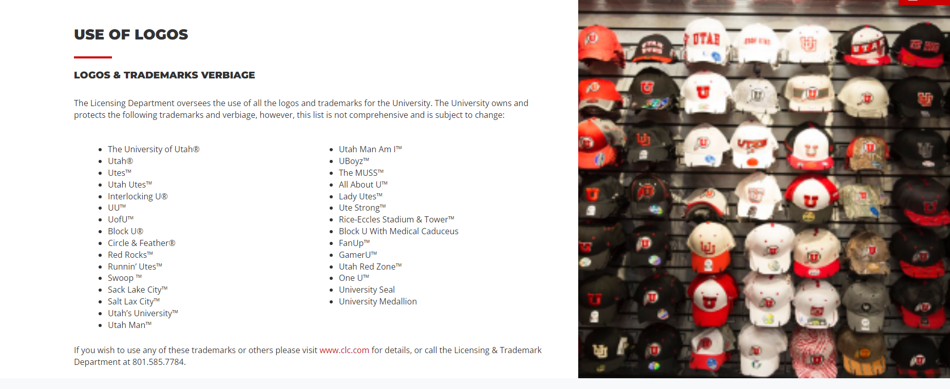

Slide 27
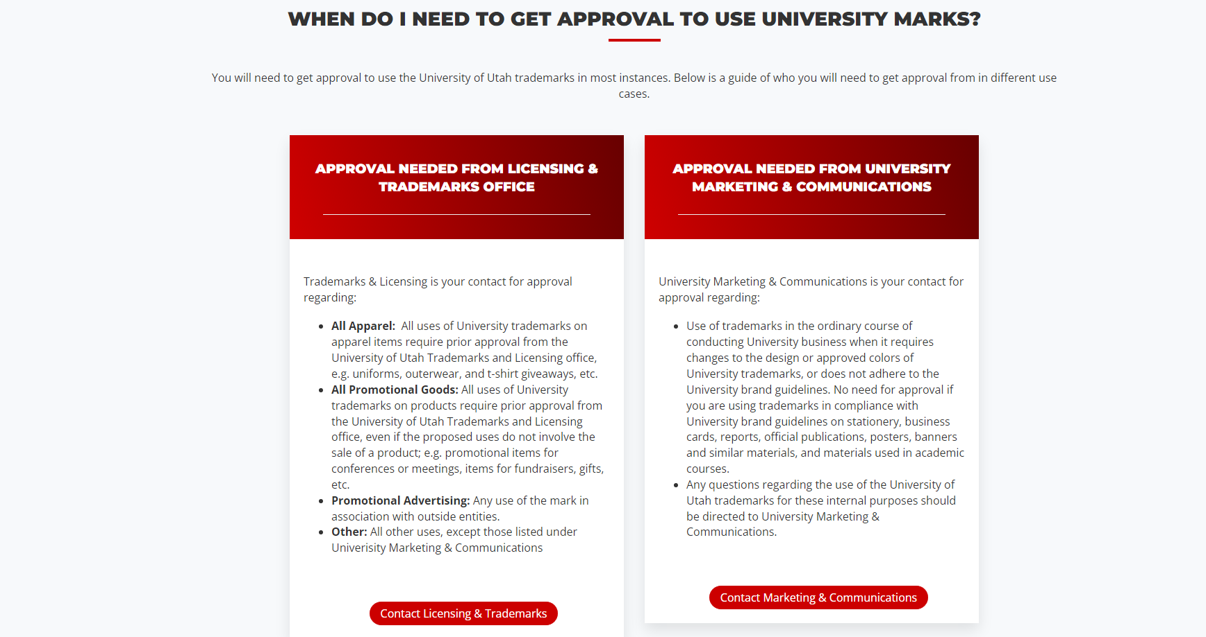

Slide 28
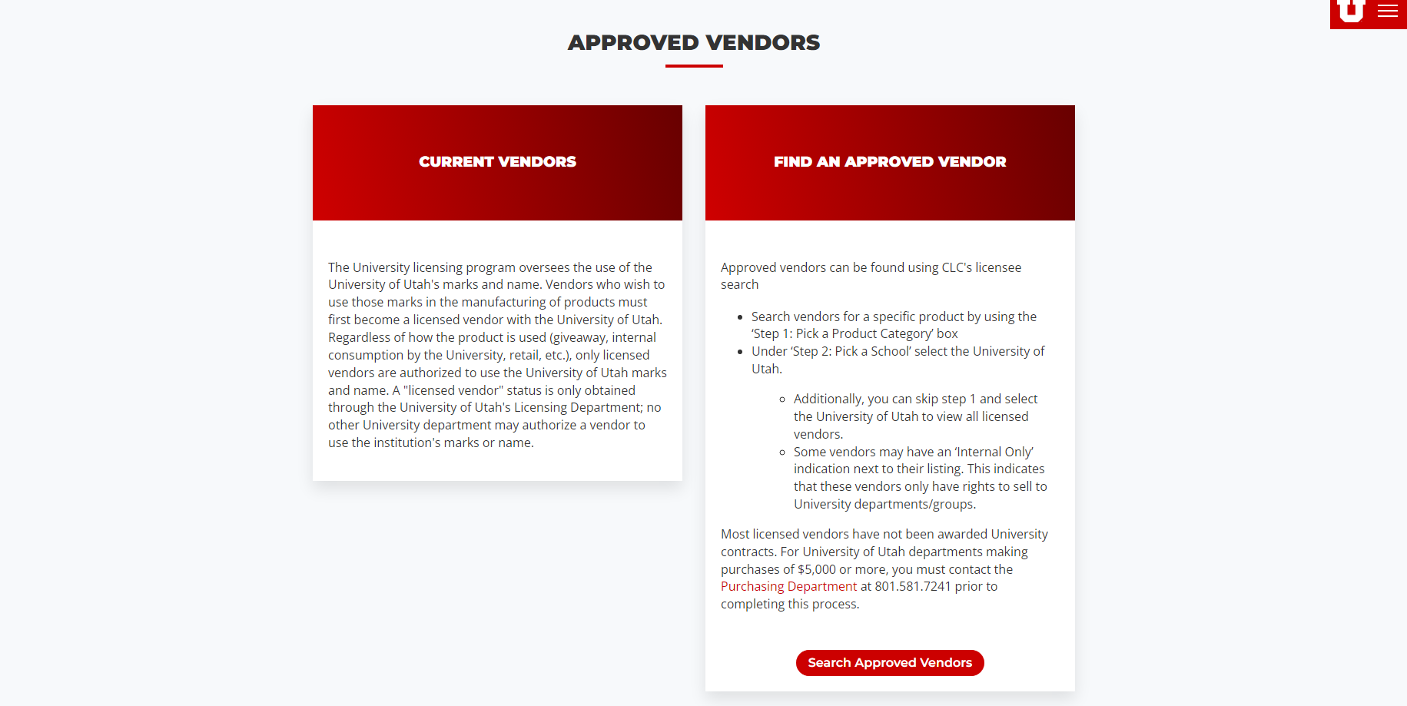

Slide 29
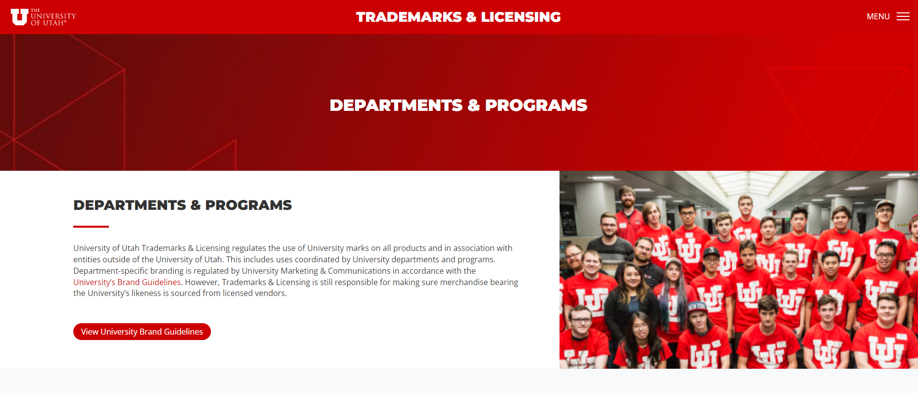

Slide 30
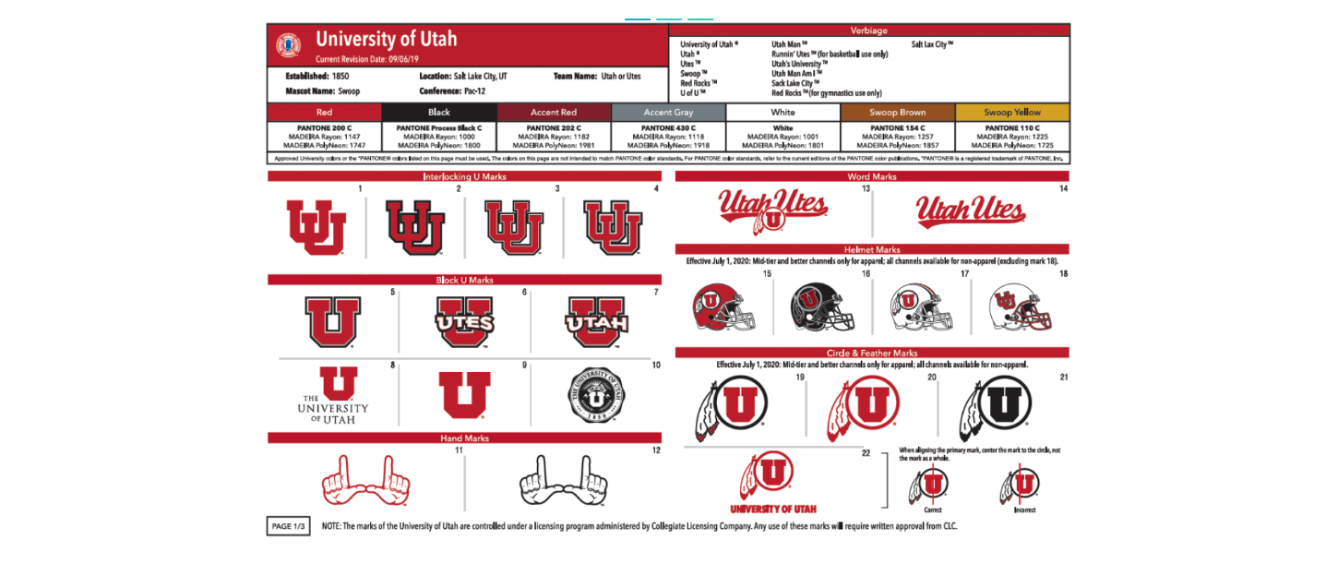

Slide 32
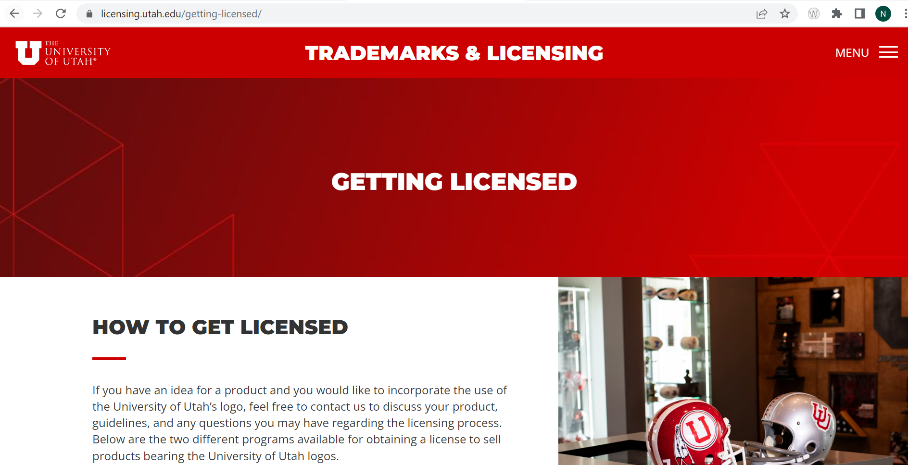

Slide 33
How to avoid trademark infringement?
What is infringement?
- Likelihood of confusion between two marks
Remember:
- even non-identical marks can infringe
- trademarks might not be registered
Check with OGC:
- before naming a product or service
- before using third-party trademarks
- get permission
Notes:
Official Document - A written agreement, proposal, or other formal instrument regarding a course of action, the expenditure of University funds, or other contractual obligation - which is intended to be binding upon the University. Official Documents obligate the University as a whole, or its divisions, to act, engage, consent, perform, or pay. Typically, at least one party to the transaction is external to the University. Official Documents may be in the form of contracts, proposals, agreements, statements, notices, resolutions, letters, memorandums, licenses, indentures, etc. But such documents may go by other names as well.

Slide 34
Questions?

Slide 35
Contracts: Key Considerations
Brian Watts

Slide 36
What is a contract?
A rose by any other name would smell as sweet.
Memorandum of Understanding
License
Statement of Work
Quotation
Titles do not matter. Substance matters.
Policy 3-004 applies to “Official Documents”
Notes:
Official Document - A written agreement, proposal, or other formal instrument regarding a course of action, the expenditure of University funds, or other contractual obligation - which is intended to be binding upon the University. Official Documents obligate the University as a whole, or its divisions, to act, engage, consent, perform, or pay. Typically, at least one party to the transaction is external to the University. Official Documents may be in the form of contracts, proposals, agreements, statements, notices, resolutions, letters, memorandums, licenses, indentures, etc. But such documents may go by other names as well.

Slide 37
Avoid false starts!
Be mindful when interacting with vendors.
Coordinate with Purchasing.
When in doubt, ask.
Image: Freepik.com

Slide 38
Finalizing a contract is a team effort.
Compliance with procurement process requirements.
Negotiation of key business/operational terms and conditions.
Ancillary reviews
Information Security
HIPAA Considerations
Risk Management
Image: Freepik.com

Slide 39
What to expect
Development or review of contract language.
Operating units should take the lead on operational and business terms.
Direct advice to the University operating unit.
Professional ethics obligations limit our ability to interact directly with third parties.
Plan ahead!
Contract negotiation can take a considerable amount of time depending upon the complexity of the arrangement (and reasonableness of the external party).
The Office of General Counsel provides legal advice to the University of Utah.
This includes advising on contract development and negotiation.
Image: Freepik.com

Slide 40
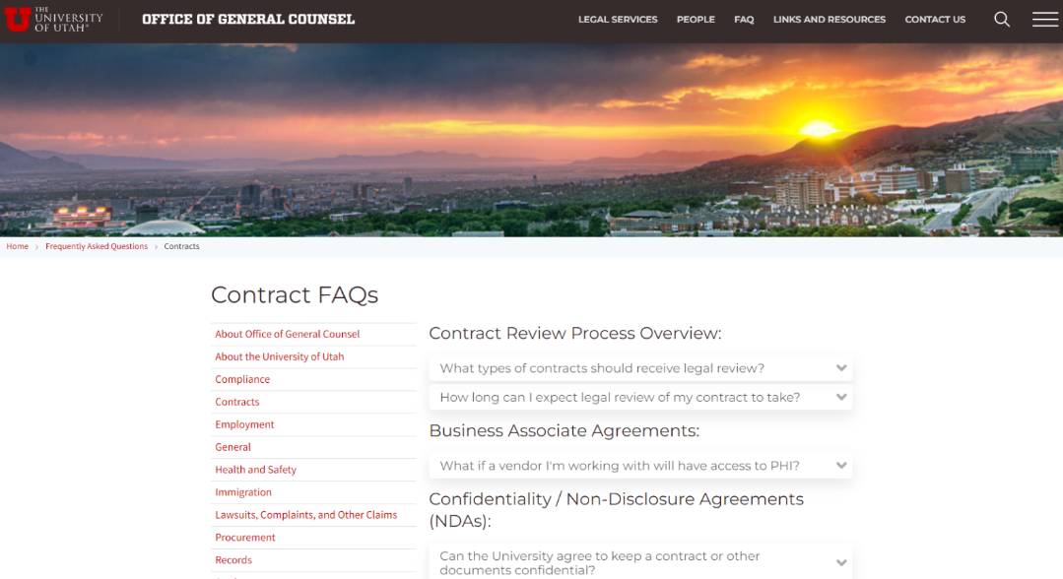
Connecting with the Office of General Counsel
Visit our website!
www.legal.utah.edu
Contact Information
FAQs
Other Resources
Depending on your area, procurement and contract routing processes may connect you directly to the Office of General Counsel, e.g. Archer.

Slide 41
Contract Mindfulness: More than price matters!
Important Points to Consider
Length of Term
Early Termination
Limitation of Liability
Defense and Indemnification
Information Privacy/Security
Choice of Law/Venue
Insurance Expectations
Confidentiality
Image: Freepik.com

Slide 42
Signature Authority/Process
University Policy 3-004: Processing and Signing Official Documents
Applies to “Official Documents.”
Essentially any writing that obligates a particular course of action or receipt/payment of funds other than routine transactions, e.g., campus orders, limited purchase orders, travel reimbursements.
Only a cognizant University Officer is authorized to sign official documents.
Signature authority can be delegated.

Slide 43
Inflation Reduction Act of 2022
Hailey Ritchie

Slide 44
Extends Enhanced Premium Subsidies
“Subsidy Cliff”
Individual: $13,590
Family of 4: $27,750
Individual: $54,360
Family of 4: $111,000
0% FPL
100% FPL
400% FPL
Ineligible
Eligible
Ineligible
ACA: percentage of income paid for marketplace benchmark premiums range from 2.07% to 9.83%
ARPA: for 2021 and 2022, percentage of income paid for marketplace benchmark premiums range from 0% to 8.5%
IRA: extends ARPA’s enhanced subsidies through 2025

Slide 45
Cynthia Cox, Krutika Amin, and Jared Ortaliza, Five Things to Know about the Renewal of Extra Affordable Care Act Subsidies in the Inflation Reduction Act, (KFF, August 11, 2022) https://www.kff.org/policy-watch/five-things-to-know-about-renewal-of-extra-affordable-care-act-subsidies-in-inflation-reduction-act/ (August 17, 2022)

Slide 46
Requires Medicare to Negotiate Prices for Certain Drugs
Medicare Part D
(Retail Drugs)
Medicare Part b
(Drugs administered by physicians)
Medicare
Medicare pays 106% of Average Sales Price or ASP (ave. price to all non-federal purchasers in U.S.)
If no ASP available, Medicare pays 103% of Wholesale Acquisition Cost or WAC (list price)
“Non-Interference Provision”
Part D Plans (and MA-PD Plans) / PBMs
Drug Manufacturers

Slide 47
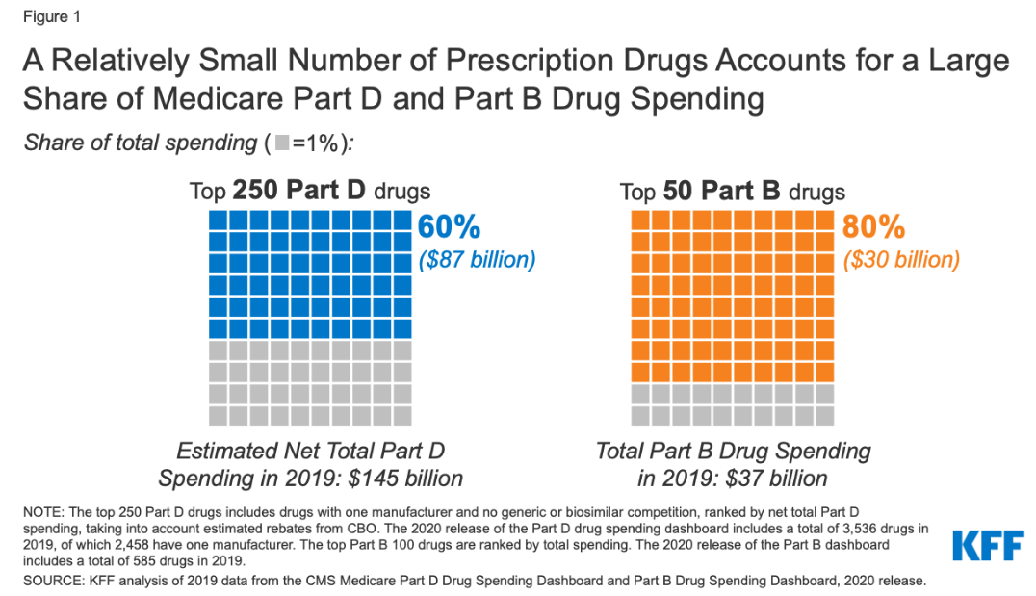
Requires Medicare to Negotiate Prices for Certain Drugs
Single source drugs under Parts D and B
Except orphan drugs, plasma-derived products, and low-spend drugs (<$100)
High-spend drugs
Juliette Cubanski and Tricia Neuman, Relatively Few Drugs Account for a Large Share of Medicare Prescription Drug Spending, (KFF, April 19, 2021) https://www.kff.org/medicare/issue-brief/relatively-few-drugs-account-for-a-large-share-of-medicare-prescription-drug-spending/#:~:text=Medicare%20Part%20B,-Medicare%20Part%20B&text=Part%20B%20covers%20a%20substantially,drugs%20are%20relatively%20costly%20medications (August 18, 2022)

Slide 48
Requires Medicare to Negotiate Prices for Certain Drugs
Been on market for several years
15 Part D or Part B Drugs
20 Part D or Part B Drugs
First drugs selected for negotiation of “maximum fair price”
10 Part D Drugs
15 Part D Drugs
2023
2024
2025
2026
2027
2028
2029

Slide 49
Caps Certain Drug Costs
Total out-of-pocket Medicare Part D drug costs capped at $2,000/year
Cost of insulin for Medicare beneficiaries capped at $35/month per prescription for:
Covered insulin products in Part D; and
Insulin furnished through DME in Part B
Does NOT apply to private plans

Slide 50
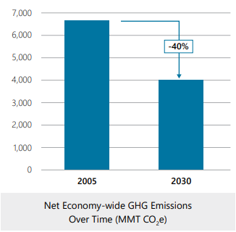
Climate Provisions: 10 Takeaways
Single largest climate and energy investment in U.S. history ($368B)
Expected to drive significant emissions reductions
Over $60B for environmental and climate justice initiatives
Office of Environmental Justice and External Civil Rights (EPA)
Justice40 Initiative
Over $250B for conservation, ecosystem, and habitat restoration projects on NPS and BLM lands
Lots of drought mitigation funding opportunities, especially in the Colorado River Basin
U.S. Dep’t of Energy, Office of Policy, The Inflation Reduction Act Drives Significant Emissions Reductions and Positions America to Reach Our Climate Goals (Aug. 2022),
https://www.energy.gov/sites/default/files/2022-08/8.18%20InflationReductionAct_Factsheet_Final.pdf.

Slide 51
https://www.whitehouse.gov/cleanenergy/?utm_source=cleanenergy.gov
Multiple financial incentives will help make clean energy options more accessible to consumers
Focus on clean energy production and manufacturing in the U.S.
New “methane fee”

Slide 52
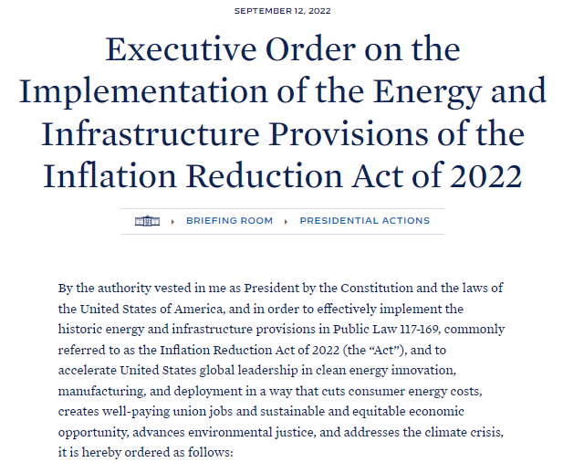
Not everyone is happy
It’s all about the details

Slide 53
How will U of U Health respond to climate-related crises?
What actions should the U take to equitably respond to climate change?
How should education and research at the U respond to climate change?
Which climate actions should be prioritized?
Notes:
The U is currently seeking input on a new, equity-centered Climate Change Action Plan, which will define steps toward a more sustainable and equitable future.

Slide 54
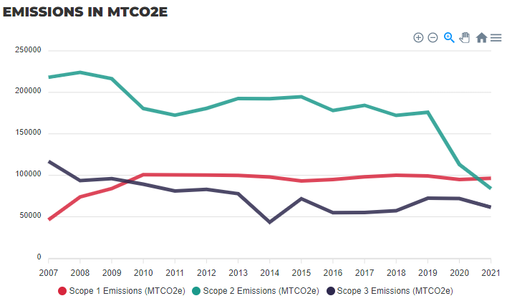
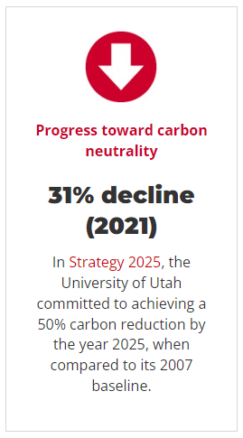
https://sustainability.utah.edu/dashboard/

Slide 55
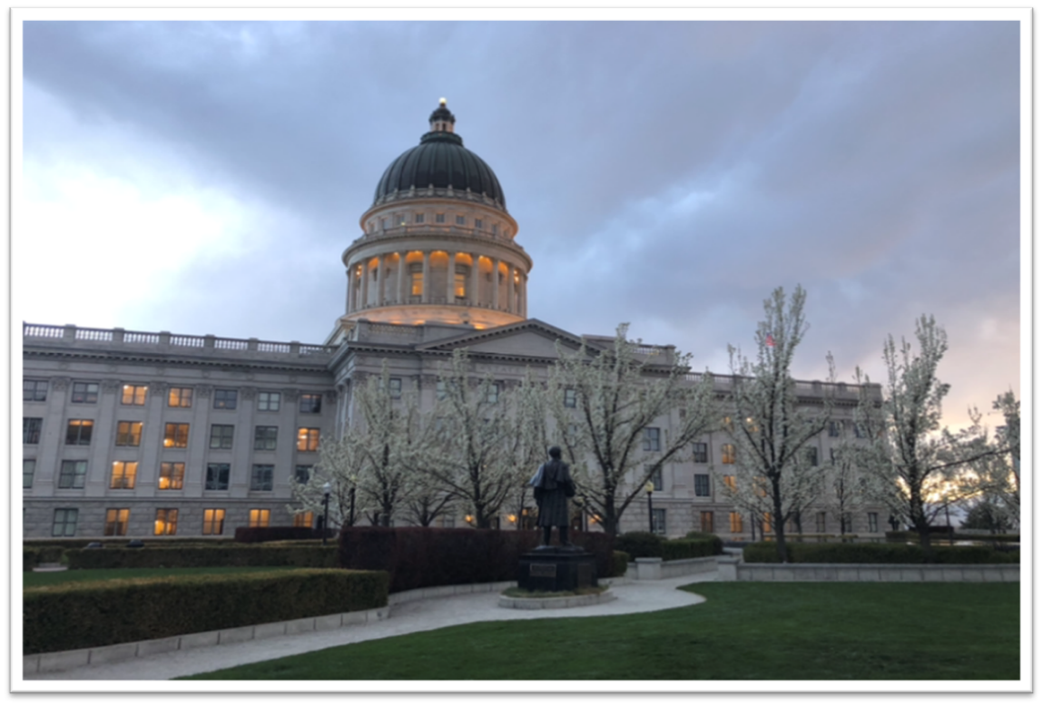
Key Issues in Utah Legislation
Rebekah Bradway

Slide 56
Data Privacy
SB 226 Higher Education Data Privacy and Governance Revisions (Sen. Anderegg and Rep. J. Moss)
Creates a higher education privacy advisory group to advise institutions regarding student data protections
Requires institutions of higher education to:
Adopt certain privacy policies
Create a data governance plan
Include certain provisions in agreements with third-party contractors that receive student data from the institution

Slide 57
Financial Aid
HB 355 Higher Education Financial Aid Amendments (Rep. Peterson and Sen. Millner)
Modifies provisions related to higher education financial aid, including provisions related to:
Public Safety Officer Career Advancement Reimbursement Program
Opportunity Scholarship
Access Utah Promise Scholarship
Terrel H. Bell Teaching Incentive Loan Program
Success Stipend Program
Strategic Workforce Investment

Slide 58
Higher Education
HB 226 Higher Education and Corrections Council (Rep. Snow and Sen. Owens)
Creates the Higher Education and Corrections Council to advise the Utah Board of Higher Education and the Legislature regarding the development and delivery of accredited higher education curriculum to incarcerated individuals in the state correctional system
HCR 16 Concurrent Resolution Recognizing Student Athletes’ Right to Religious Freedom and Modesty (Rep. Pierucci and Sen. Cullimore)
Encourages institutions of higher education, among other entities, to revise any policies and practices that prevent athletes from wearing religious clothing and headwear while participating

Slide 59
Holidays and Leave
HB 238 State Holiday Modifications (Rep. Hollins and Sen. Anderegg)
Provides that Juneteenth National Freedom Day is a state holiday
SB 63 Bereavement Leave Amendments (Sen. Harper and Rep. Acton) & HB 449 Bereavement Leave Modifications (Rep. Shipp and Sen. Harper)
Require the Utah Board of Higher Education to adopt a policy requiring institutions of higher education to provide at least three work days of paid bereavement leave for employees who are affected by a miscarriage or stillbirth

Slide 60
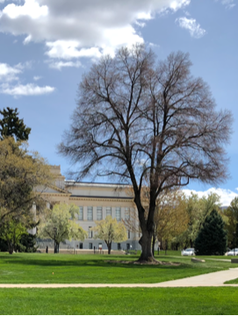
Facilities Management
SB 82 State Facilities Management Amendments (Sen. Buxton and Rep. Brammer)
Amends provisions relating to the management of state facilities, including by:
Eliminating the State Building Board
Modifying provisions related to the supervision and control of the allocation of space for institutions of higher education
HB 121 Water Conservation Amendments (Rep. Spendlove and Sen. McKell)
Imposes requirements related to water conservation at state government facilities and by state agencies

Slide 61
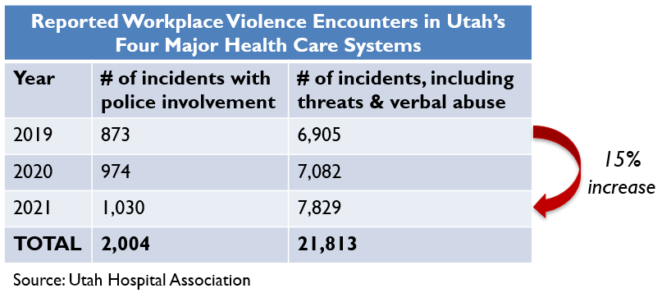
Protections for Health Care Personnel
HB 32 Health Care Worker Protection Amendments (Rep. Spendlove and Sen. Ipson)
Enacts enhanced penalties for assault or threat of violence against an owner, employee, or contractor of a health facility (e.g., hospital, clinic, etc.)
Class A misdemeanor
3rd degree felony if actor causes substantial bodily injury and acts intentionally or knowingly

Slide 62
Workforce / Training
HB 176 Utah Health Workforce Act (Rep. Thurston and Sen. Anderegg)

Slide 63
Workforce / Training
HB 295 Physician Workforce Amendments (Rep. Maloy and Sen. Vickers)
Creates 2 grant programs to facilitate the creation of:
New ACGME-accredited residency programs or the expansion of current residency programs
Priority:
New/existing residency programs that address a workforce shortage in Utah for a specialty; or
Serve an underserved population, including a rural population
A forensic psychiatrist fellowship program
Recipient must contract with the Dep’t of Corrections to provide forensic psychiatric services

Slide 64
Malpractice / Litigation
HB 344 Utah Medical Candor Act (Rep. Nelson & Sen. Kennedy)
Extension of the “apology statute”
Creates a process by which a health care provider may investigate an injury, or a suspected injury, associated with a health care process and confidentially communicate about the investigation to the patient (or a rep) without the risk of having those communications used against the provider later on
HJR 13 Joint Resolution Amending Court Rules of Procedure and Evidence to Address the Medical Candor Process (Rep. Nelson & Sen. Kennedy)
Amends court rules of procedure and evidence to address the medical candor process established in HB 344

Slide 65
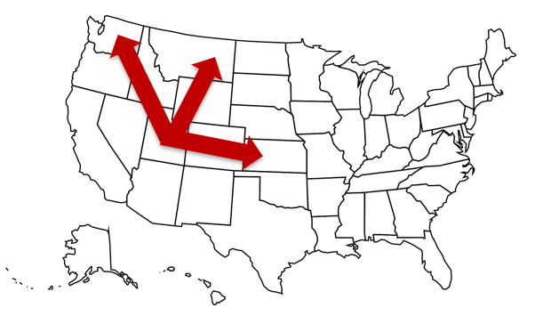
Interstate Compacts
SB 151 Advanced Practice Registered Nurse Compact (Sen. Bramble and Rep. Dunnigan)
Enacts the APRN Compact (effective when 7 states join; 2 have joined on so far)
Multistate licensure
Must satisfy each state’s prescriptive authority requirements
SB 237 Counseling State Compact (Sen. Bramble and Rep. King)
Enacts the Counseling Compact (effective when 10 states join; 5 have joined on so far)
Social workers, marriage and family therapists, and clinical mental health counselors may participate
Individuals obtain a “privilege to practice” in remote states

Slide 66
Looking Ahead
Medicaid
Mental Health Treatment
Student Athletics
Technology Commercialization
Pregnancy Termination
Transgender Health Care
Employee Benefits
Professional Licensing
Hundreds more bills

Slide 67
Retaliation, Abusive Conduct and Whistleblower Concerns
Julie Thomas

Slide 68
Retaliation

Slide 69
Retaliation
Litigation threat, significantly increasing claims
Federal & State Laws
University policies prohibit retaliation
Nondiscrimination Statement
University Non-discrimination Policy
HR policies regarding grievance process and egregious conduct
Violence in the workplace
Research misconduct
Safety of Minors
Abusive Conduct
Whistleblower

Slide 70
Practical Tips
Consistency in enforcing policies
Follow process/policy
Maintain detailed documentation
Recognize post-employment actions can be adverse action for retaliation claim
Expanded scope of claims—3rd party claims against employer
Manage abusive conduct and whistleblower concerns properly

Slide 71
Abusive Conduct

Slide 72
State Law/University Policy
Utah Statute
Utah Public Employees Healthy Workplace Act (UCA 67-26-201)
Policy of the state to provide and maintain a work environment free from abusive conduct.
Process for abusive conduct complaints
Policy 1-021
University committed to an academic and work environment that promotes, facilitates, and encourages mutual respect and collegial relationships
Applies to all UofU employees and all academic and administrative units
Definition of abusive conduct—Physical, verbal, or nonverbal conduct by an employee toward another employee (such as derogatory remarks, insults, or epithets) that based on the severity, nature, or frequency of the conduct, a reasonable person would determine any of the following:
Intends to intimidate, humiliate, or cause unwarranted distress;
Exploits an employee’s known physical or psychological disability; or
Is unwarranted and results in substantial physical or psychological harm as a result of intimidation, humiliation, or distress.

Slide 73
Reporting and Resolving
Employee who engages in abusive conduct may be subject to discipline
What it is not
Appropriate disciplinary and administrative actions
Appropriate developmental or critical performance-related feedback
Reasonable work assignments or job reassignments
Reasonable differences in styles of management, communication, expression or opinion
Process for reporting and resolving
Depends on classification of respondent (faculty, hospital/clinic staff, employees who are not faculty or hospital/clinic staff)
Training
Practical Tips

Slide 74
Whistleblowers on Campus

Slide 75
What is a Whistleblower?
An employee who raises concerns about the misuse of public resources (fraud, waste, abuse), violations of the law or safety/ethical concerns, etc.

Slide 76
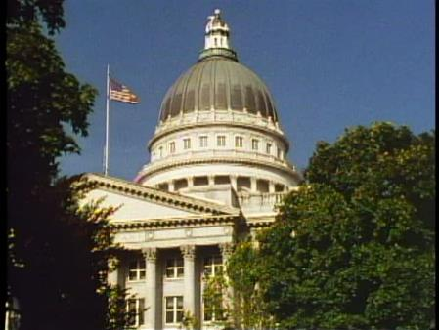
Utah Statute
Utah Protection of Public Employees Act
Prohibits government employers from taking retaliatory action against an employee because the employee, in good faith, complained of waste, misuse of public funds, violations of law, etc.
Recently amended definition of “retaliatory action” (University policy to be revised accordingly)
Requires institutions of higher education to hold hearings for employees who believe they have experienced retaliatory action because they engaged in whistleblowing activities.

Slide 77
Policy 5-211
Applicable to all employees (regardless of whether faculty or staff, part-time or full-time)
If an employee believes they have experienced retaliatory action because of engaging in whistleblowing activities, the employee must file a complaint with the Director of Employee Relations.
HR has a short time frame after the complaint is filed to assemble a hearing committee.
At the hearing, the manager/supervisor must establish that the retaliatory action against the complaining employee was justified by reasons unrelated to the employee’s good faith whistleblowing activities.

Slide 78
Practical Tips
Remember goals of policy
Ensure University is a safe place and policies are followed
Provide a route for concerns to be addressed
Protect whistleblowers
Employees raising concerns of safety, fraud, abuse or waste should be routed to HR
Take concerns seriously, HR to appropriately address
Be aware of problem employees—disruption of business operation, hold accountable
No retaliation
No retaliatory action against employee engaging in protected activity
Employee protected from retaliation in both reporting and participating in process provided by policy

Slide 79
Free Speech v. Authority to Speak on Behalf of the Institution
Scott Smith

Slide 80
General Rule
All students, faculty, and staff have the right to engage in commentary, debate, and advocacy on issues that concern them
Students, faculty, and staff do NOT have the authority to speak on behalf of the University of Utah or University of Utah Health unless they have been given permission to do so by leaders

Slide 81
If you are engaging in free speech:
Clarify that you are not speaking on behalf of the organization—this means you use your:
Personal email (e.g., Gmail) and letterhead
Personal time and resources
Personal equipment and space (virtual and physical)
You may provide your work title, but if you do so, you must include a disclaimer that you are expressing your personal views and you are not speaking on behalf of the organization
REMEMBER: only designated spokespersons may speak on behalf of the organization

Slide 82
Are you speaking:
As a private citizen?
On behalf of the organization?
Off the clock
Not using university resources
Not using university badge, university uniform, university letterhead, or other university marks
Using appropriate disclaimer, especially if citing your work title
On the clock
Using university resources
Using university badge, university uniform, university letterhead, or other university marks
With knowledge of, and permission from, leaders

Slide 83
Examples
YES!
NO!
Dear Editors,
I am a lawyer practicing in Salt Lake City, Utah. I am very concerned about the new parking meters downtown. Based on my past habits, these parking meters will cost me $12.00 per day! Where will I get this money?
Sincerely,
Scott Smith
Dear Editors,
I am a lawyer employed by the University of Utah. The University and I are very concerned about the new parking meters downtown! Based on my past habits, these parking meters will cost me $12.00 per day! Where will I get this money?
Sincerely,
Scott Smith
Associate General Counsel
University of Utah

Slide 84
Examples
YES!
NO!
Dear Editors,
I am an attorney in Salt Lake City. I have practiced healthcare law for nearly year 20 years. I am writing this letter of concern based on my personal views, and not the views of my employer. I am very concerned about Senate Bill xxxx and the impact it will have on our community. I would ask that everyone with concerns write their elected representatives to voice their opinion.
Sincerely,
Scott Smith
Associate General Counsel
University of Utah
Dear Editors,
I am an attorney at the University of Utah. I am very concerned about Senate Bill XXXX. Based on my expertise in healthcare law, I foresee this law as being harmful to our community. I would encourage everyone to vote against this bill.
Sincerely,
Scott Smith
Associate General Counsel
University of Utah

Slide 85
Examples
NO!
YES!
To: xxx
From: scott.smith@legal.utah.edu
Time: Monday, 2:35 p.m.
Dear Friends and Family,
I just wanted to let you know my opinions on this new bill the Utah Legislature is considering. It’s called House Bill xxxx and it’s really a bad idea. I encourage you to vote against it.
Your pal,
Scott
To: xxx
From: scottsmith@gmail.com
Time: Saturday, 10:01 a.m.
Dear Friends and Family,
Please vote against House Bill xxxx. It’s a really bad law.
Your buddy,
Scott

Slide 86
Questions?
The Office of General Counsel
www.legal.Utah.edu
(801) 585-7002

